Slide 1
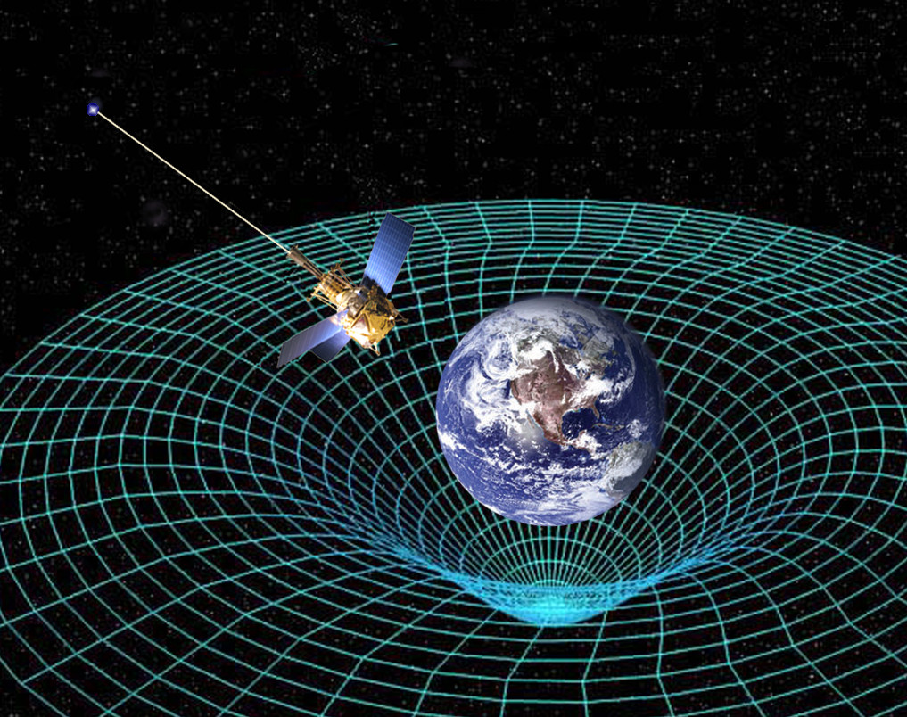
Measuring Gravitational Time Dilation with an Arduino
Zachary Moote
This Photo by Unknown author is licensed under CC BY-SA.

Slide 2
Outline
Abstract
Introduction
Methods
Expected Results
Discussion

Slide 3

Abstract

Slide 4
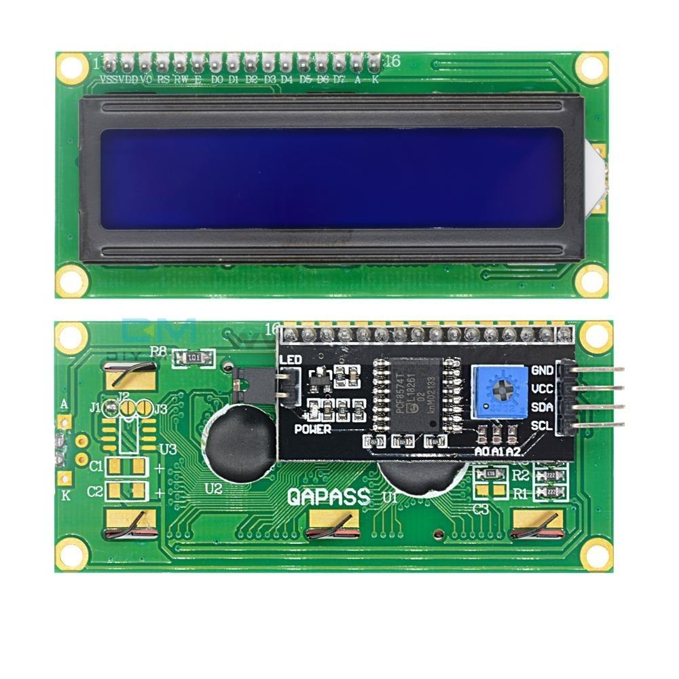
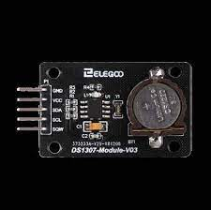
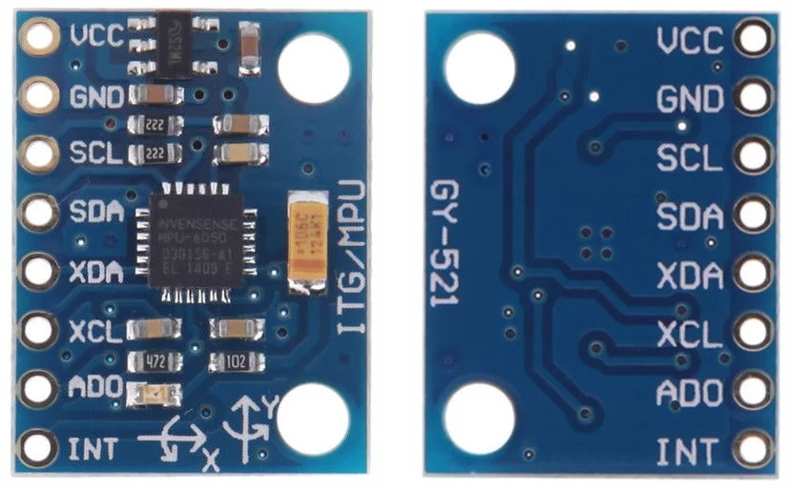
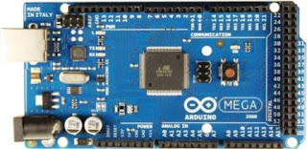
Abstract
Arduino MEGA 2560
GY-521 (Gyroscope Module)
DS1307 RTC (Real-time Clock)
LCD Display
This Photo by Unknown author is licensed under CC BY-SA.
This Photo by Unknown author is licensed under CC BY-NC-ND.

Slide 5

Introduction

Slide 6
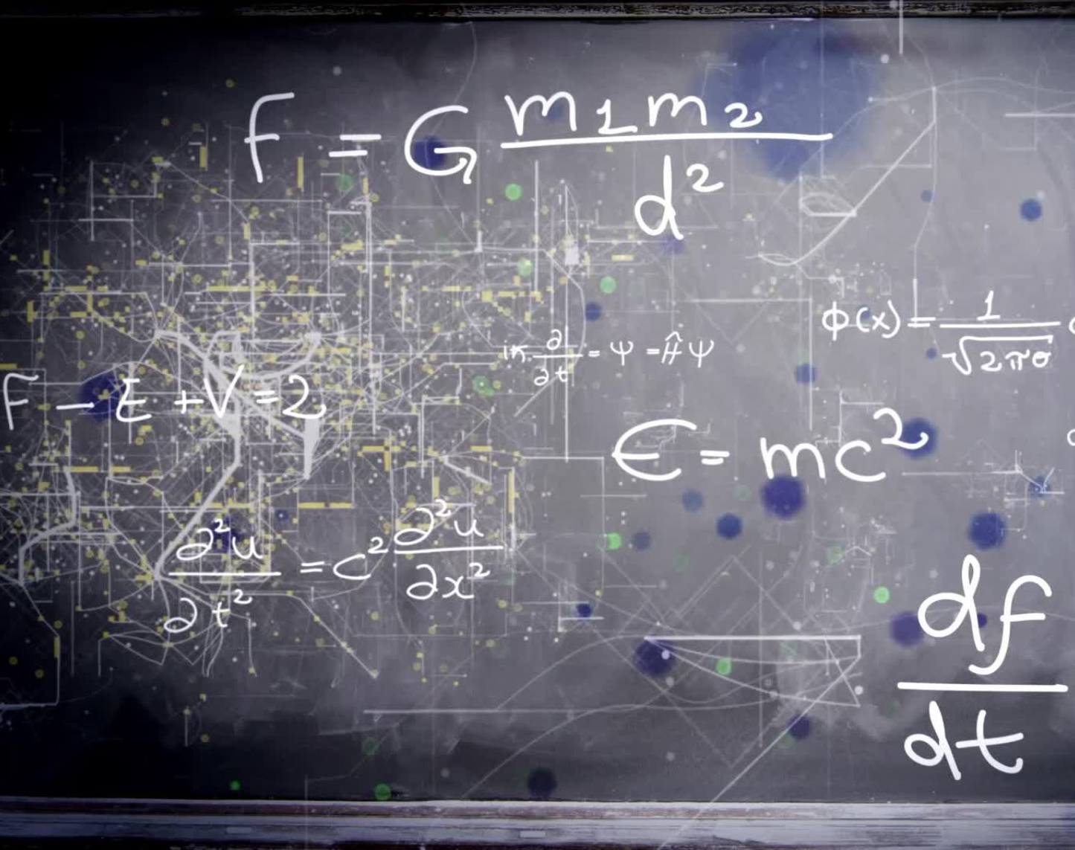
Introduction
General Relativity predicts time dilation due to gravity
Not aware of any experiments done before using Arduino specifically
Professional experiments have been performed
Precise atomic clocks at two separate elevations
Sea level vs Mountain top
Difference in passage of time was recorded

Slide 7
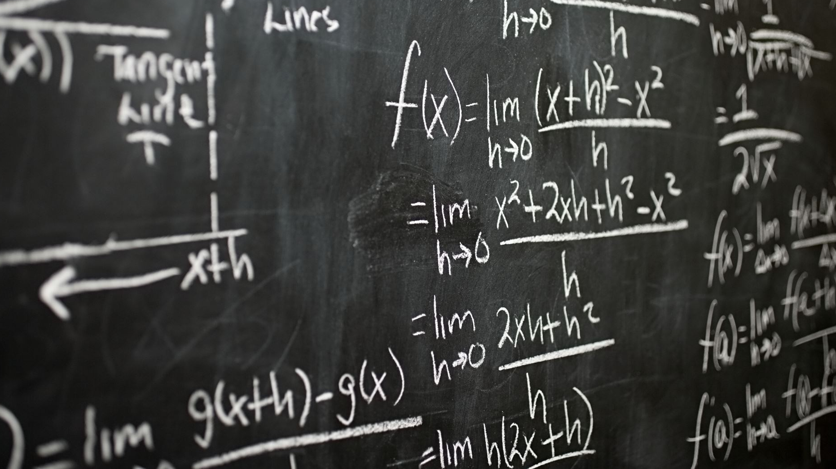
Methods

Slide 8

Methods
GY-521 will provide data from the accelerometer in the Y-axis
DS1307 RTC will measure rate of time
LCD display will show the measurements and results
Data would be recorded at different elevations on campus

Slide 9

Expected Results

Slide 10

Expected Results
I expect to see at least a small difference in the passage of time at one elevation versus another.

Slide 11

Discussion

Slide 12
Discussion
This project would allow for experimental verification of GR
Cost-effective
Great undergrad topic

